Slide 1
Checkers
Amadeus Java Academy
Veselin Antonov

Slide 2
This is my graduation project for
Amadeus Java Academy
Please feel free to ask questions at any point of the application

Slide 3
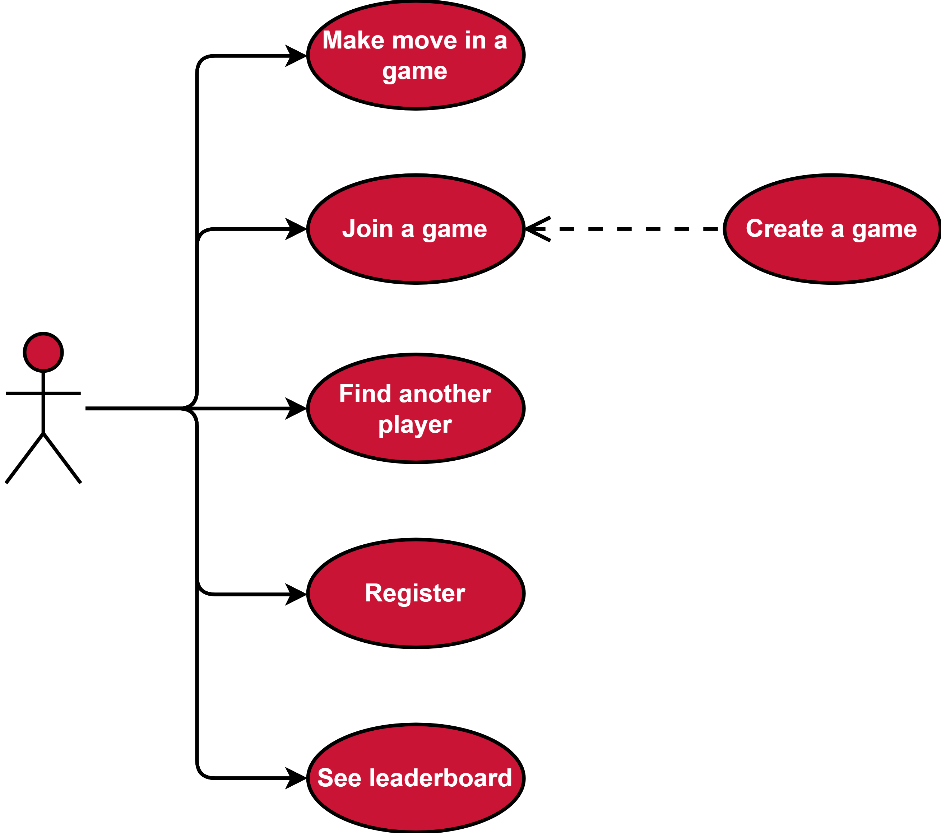
Features
Register in the system
Search for other players
See leaderboard
Create games
Singleplayer - against a bot
Multiplayer - against another player
Join a game
Participate in a game

Slide 4
REST API
Application implements a standard RESTful API interface.
Uses the HTTP request and response for communication between the client and server.
Communication for complex entities is done via JSON objects
Application is stateless, there is no context stored on the server between requests.

Slide 5
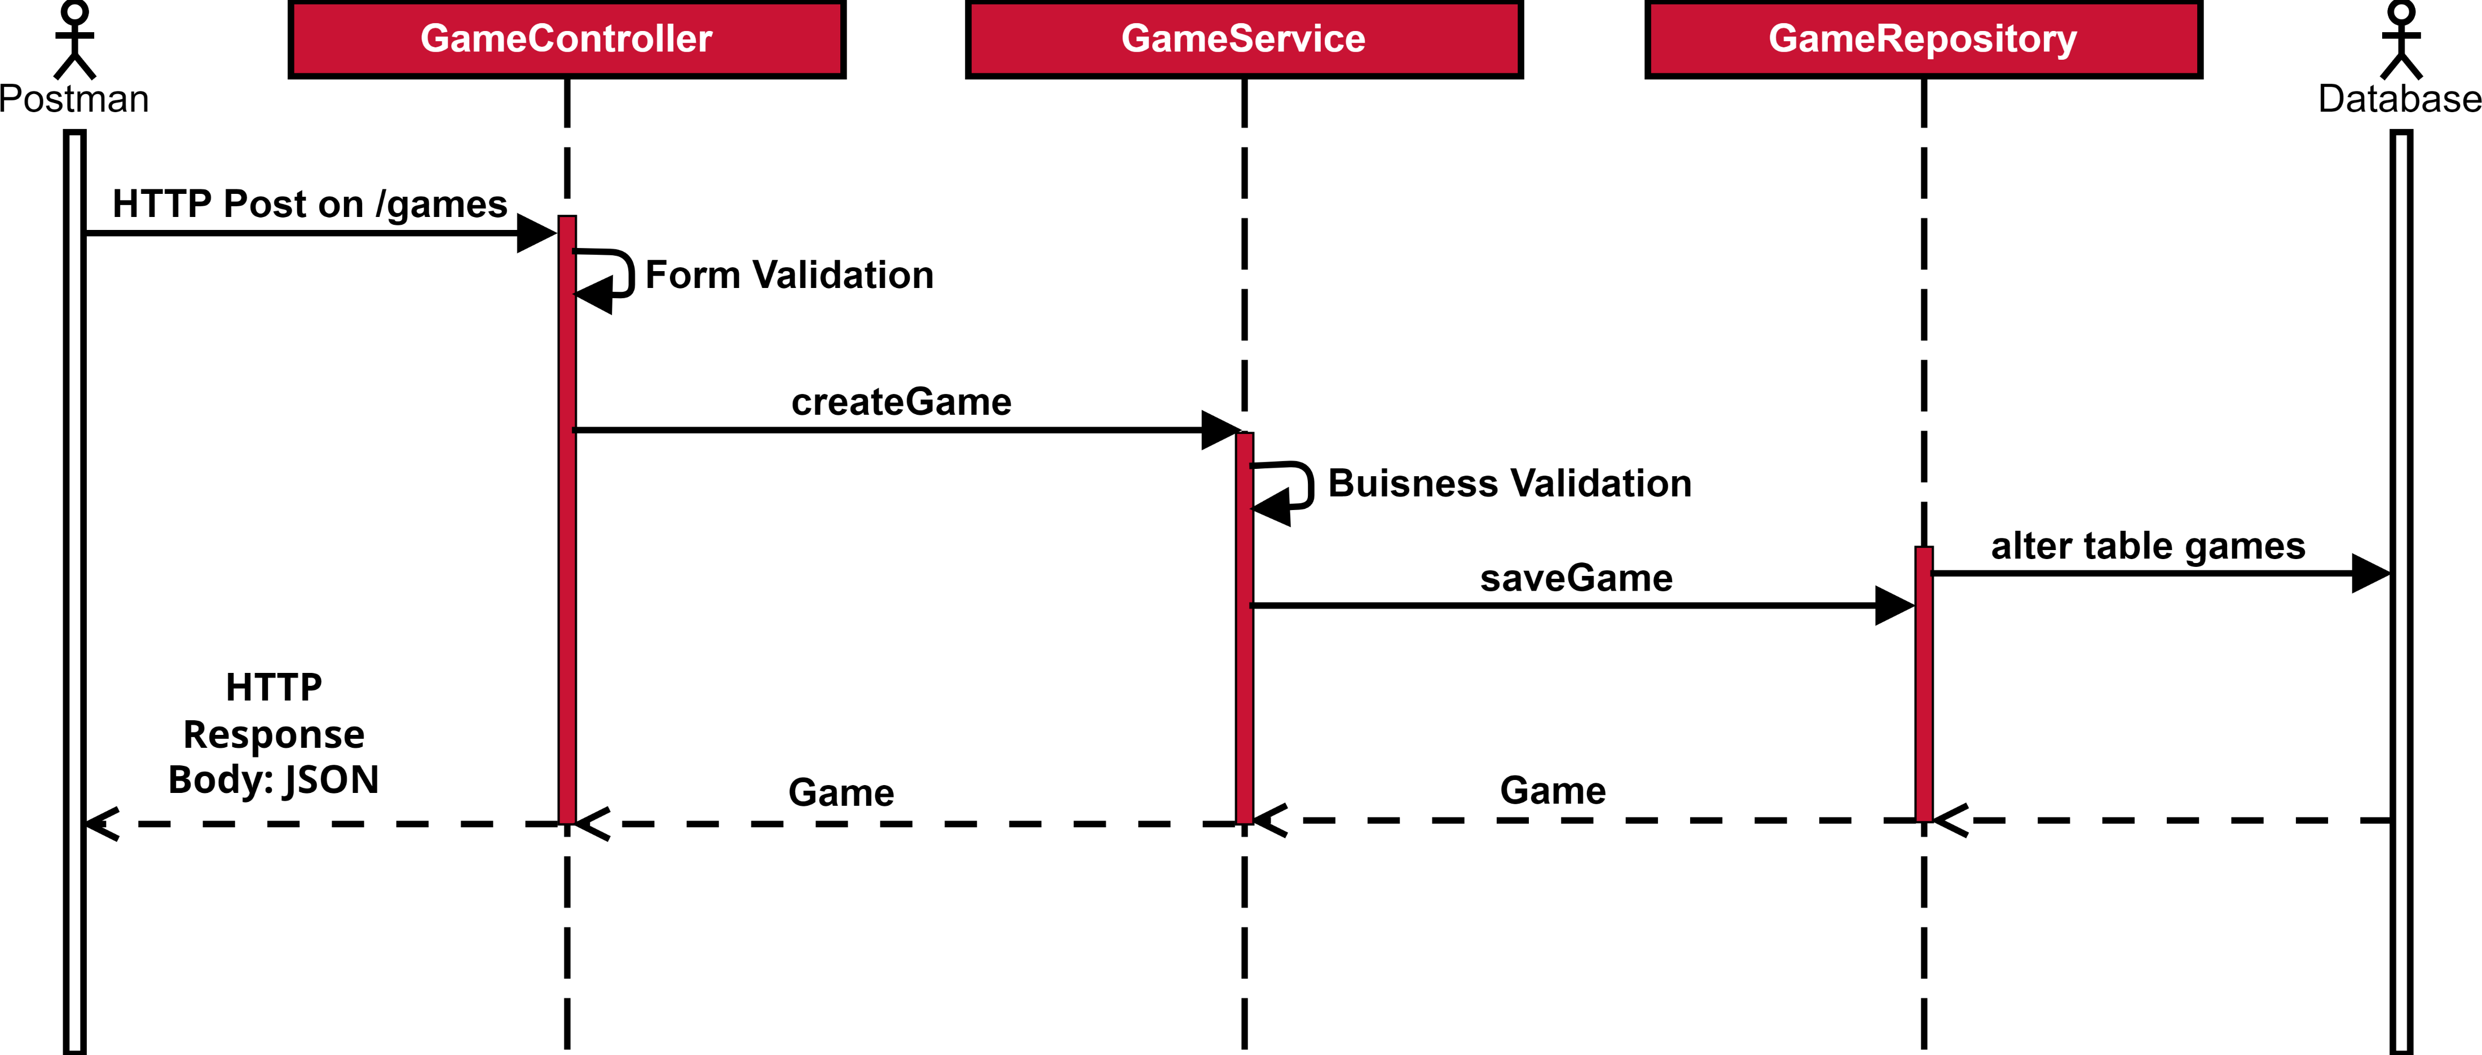

Slide 6
Architecture
The application is implemented in Spring MVC and uses standard Service Oriented Architecture
It’s packed as a .jar deployable and served by a Tomcat container
The application conforms to a Layered architecture. Higher layers can only import logic from the lower layers.
Presentation layer
Business service layer
Data layer
The application uses the Hibernate JPA implementation to communicate with the database.

Slide 7
Client
Browser, Phone, Postman, etc
HTTP Request
HTTP Response
Presentation (API)
Request Controllers
Business Logic
Business Services
Data Access
Repository, JPA
Database

Slide 8
Database
Application uses a MySQL database via Hibernate JPA.
The database lives on a MySQL server, served by a local docker container.

Slide 9
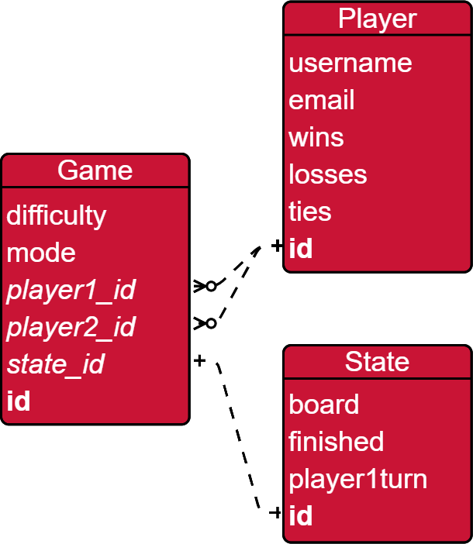

Slide 10

Algorithm Logic
The bot uses Min-Max algorithm to find an optimal move
Alpha-Beta pruning for optimization
The algorithm is depth limited to account for its growth

Slide 11
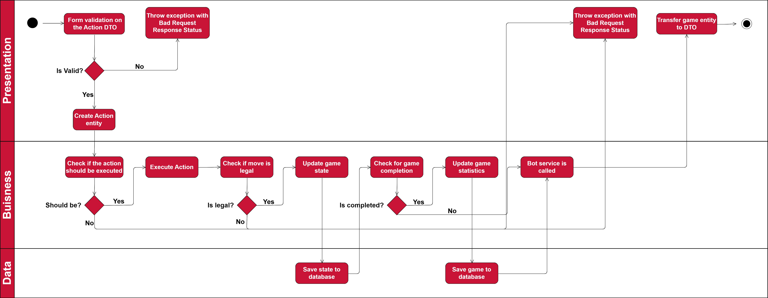

Slide 12
Let’s see a Demo
Since the application is only backend, we will present via Postman tool

Slide 13

Thank you for your attention
Please ask any question and we can also dive in the codebase ☺

